Slide 1




GSA Short Course
Age-Depth Modeling
of Sedimentary Deposits
Session 2b
Bayesian age-models - practical

Slide 2
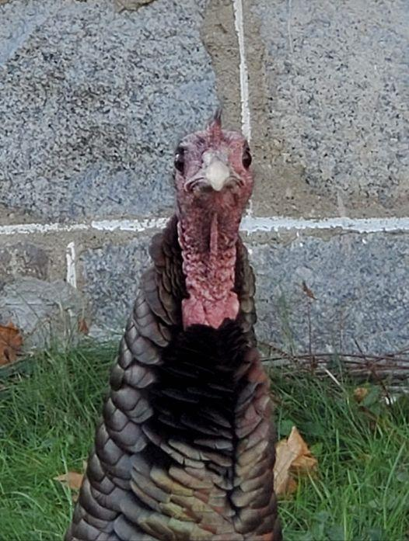
Age-depth modeling
Classical and Bayesian age-models
Hands-on of clam and Bacon in R
Next week: rplum and your own data

Slide 3
clam
Classical age-depth model
Does linear interpolation, linear/polynomial regression, spline, smooth spline, lowess
Calibrates dates
Samples from dates and draws age-depth curves

Slide 4
clam - installing
Let’s try this first, to get used to R and files
  fast, many types of classical age-models
Open R or Rstudio (a recent version, e.g. 4.0.5)
If you haven’t installed clam yet, type:
install.packages(‘clam’)
  Note upper/lower case, spaces, quotes
  No need to reinstall each time, only after updates

Slide 5
clam - loading
Now load the clam code:
require(clam)
  or
library(clam)

Slide 6
clam – age-depth models
Now run the example core, using default settings:
clam()
Clam will ask if it is OK to make a folder to store the runs. Tell clam that’s ok (if you agree with the location).
The run's files will be put in this folder: /Users/maarten/Desktop/clam_runs/Example
Warning, dates spanning beyond the calibration curve will be truncated!
Calibrating dates... Interpolating, sampling.....
Example's 95% confidence ranges span from 20 to 503 yr (average 236 yr)
Fit (-log, lower is better): 7

Slide 7
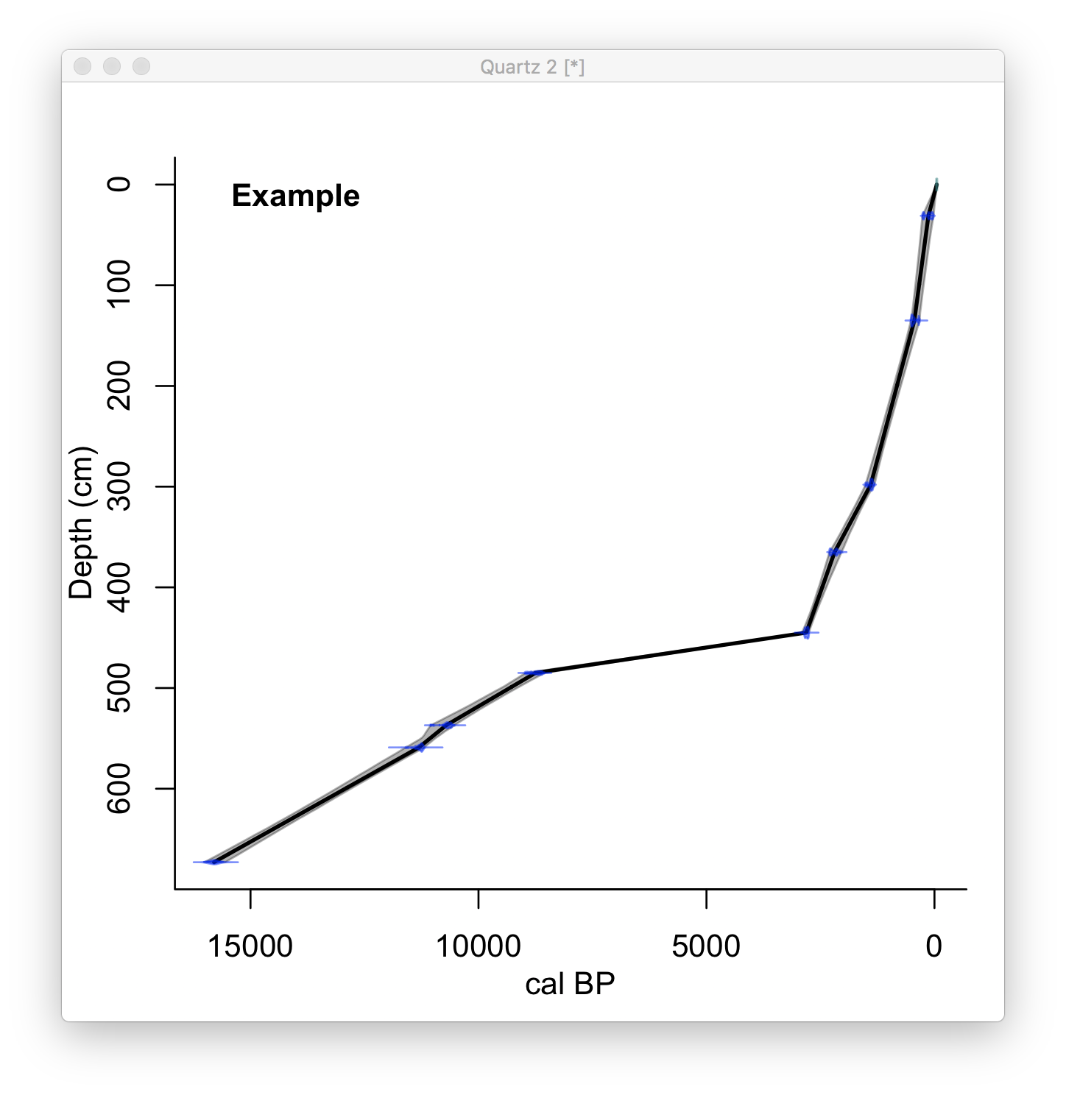

Slide 8
clam - options
Or, for example, a smooth spline (4):
clam(, 4)
Or, impose a hiatus at 470 cm depth:
clam(, 4, hiatus=470)
and there was a thick tephra at 280-270 cm depth:
clam(, 4, hiatus=470, slump=c(280, 270))
To see all clam’s options, type:
?clam

Slide 9
clam - files
Each time, files will be made with the dates, ages for each depth, and also pdfs of the age-depth models.
If allowed, clam will create an umbrella-folder “clam_runs” from the directory where it is working.
Clam will tell you where it put the files:
clam()
The run's files will be put in this folder: /Users/maarten/Desktop/clam_runs/Example
Warning, dates spanning beyond the calibration curve will be truncated!
Calibrating dates... Interpolating, sampling.....
Example's 95% confidence ranges span from 20 to 503 yr (average 236 yr)
Fit (-log, lower is better): 7

Slide 10
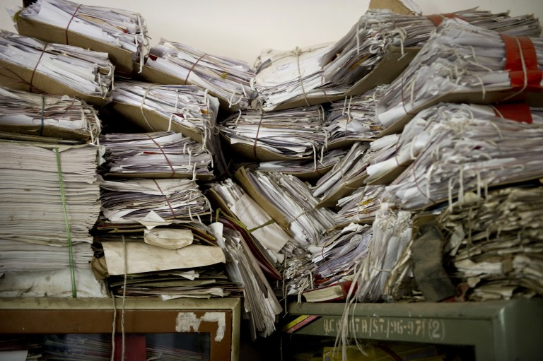

Slide 11
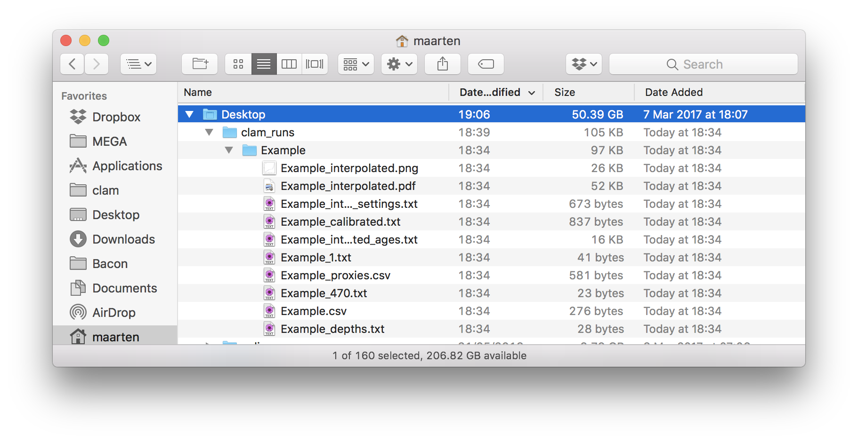
clam – folders and files

Slide 12
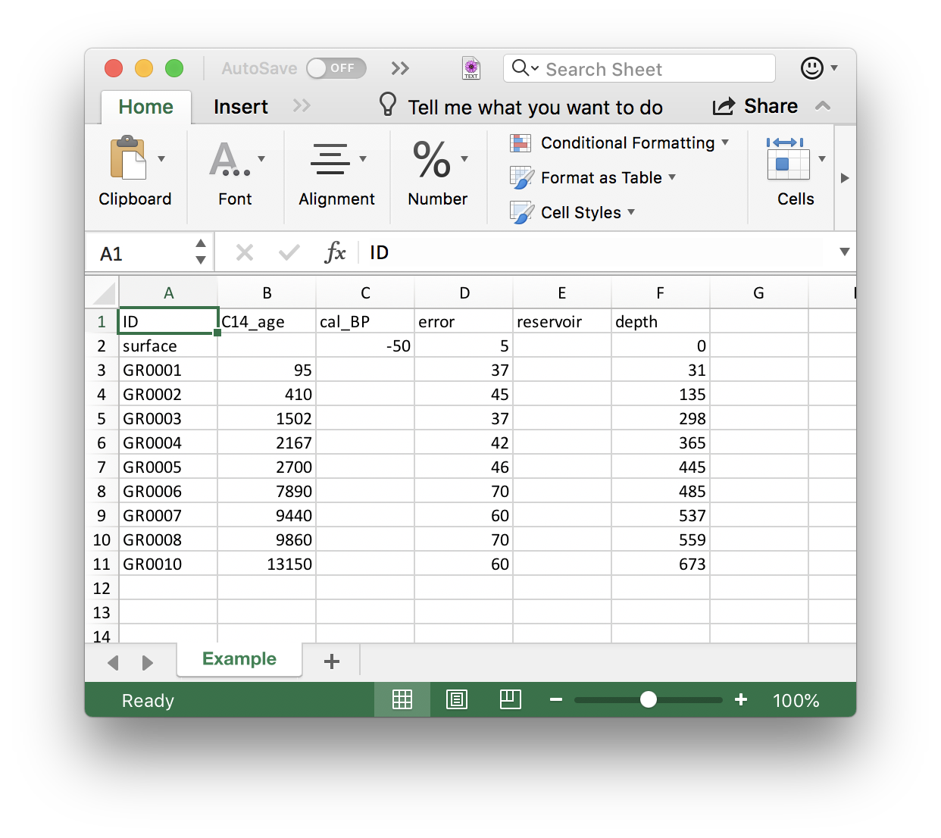
clam - .csv file

Slide 13
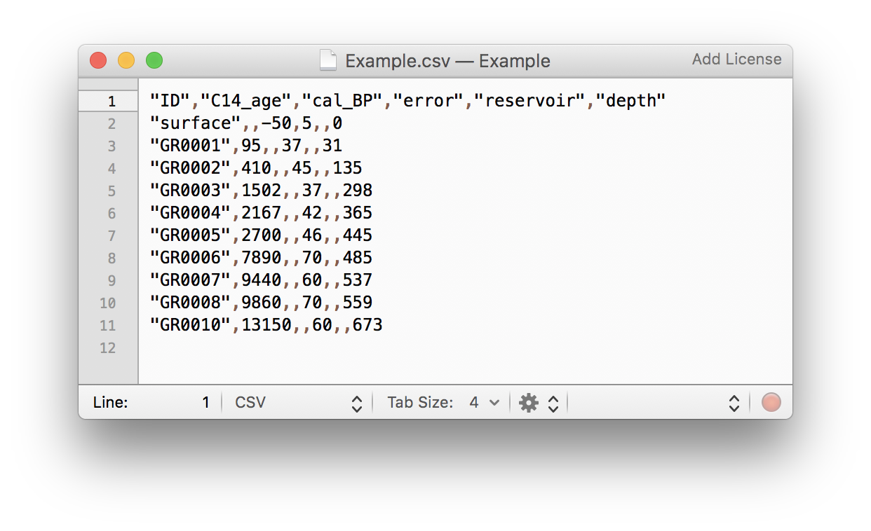
clam - .csv file

Slide 14
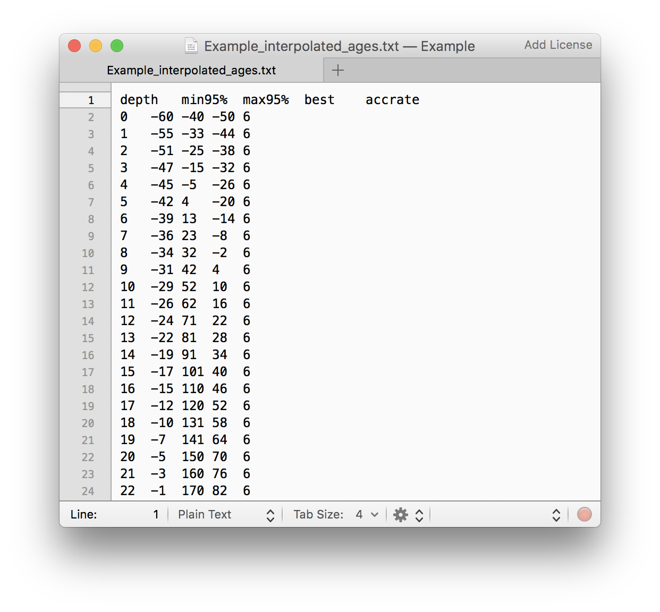
clam – ages.txt

Slide 15
clam - folders
Tell clam where to put folders (e.g., USB stick on E:\):
clam(, coredir=“E:\”)
Clam will then produce a folder called “Example” under E:\
Or query and change R’s current working directory:
getwd()
setwd(“E:\”)

Slide 16
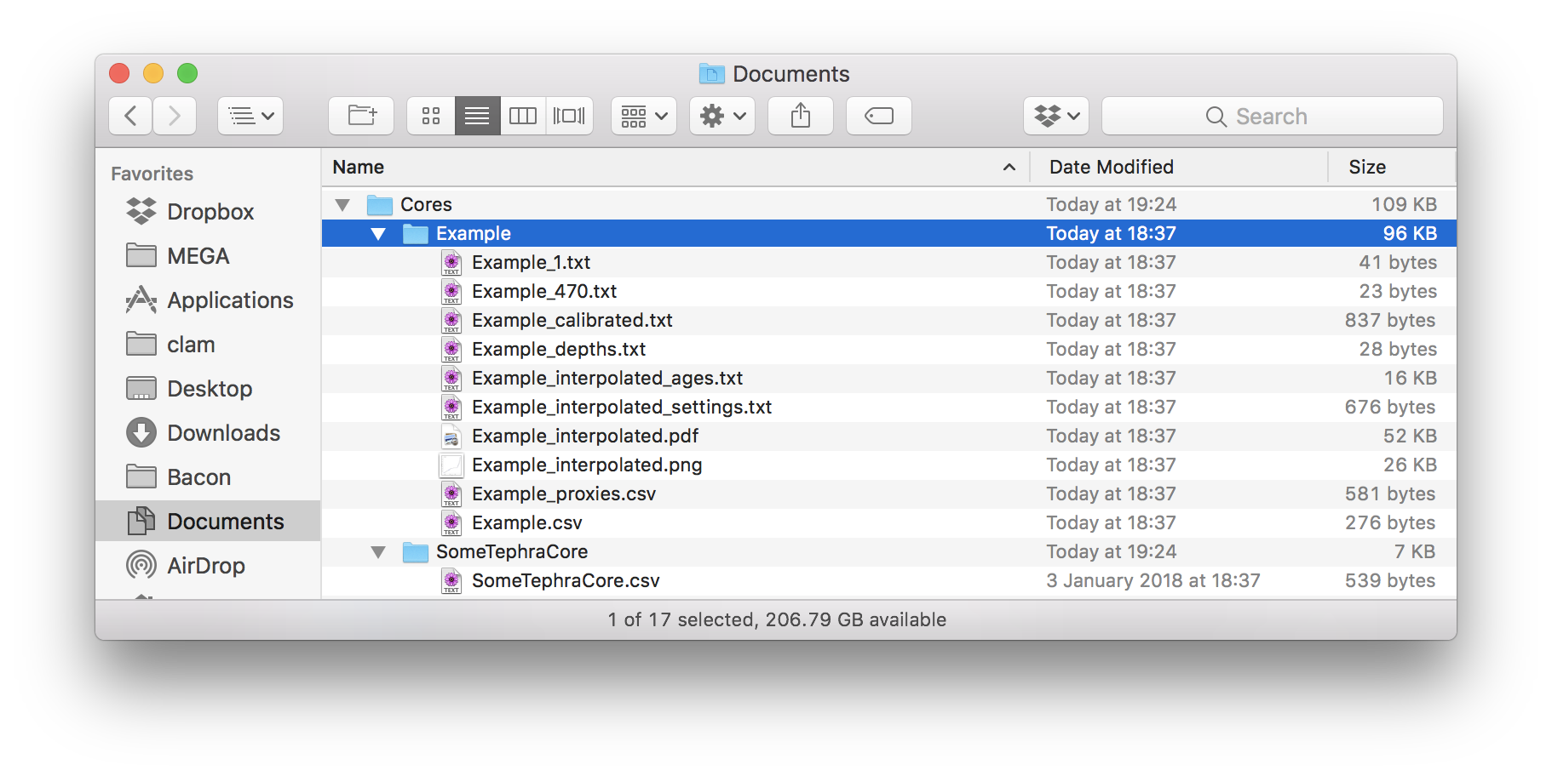
clam – your core
Add a folder under folder clam_runs or Cores
Place your core’s .csv file in it
Then in R:
clam(“SomeTephraCore”)

Slide 17

Pixel & Sophie
(facebook)

Slide 18
Bacon - installing
If you haven’t installed Bacon yet, type:
install.packages(‘rbacon’)
  Note upper/lower case, spaces, quotes
  No need to reinstall each time, only after updates

Slide 19
Bacon - loading
Now load the Bacon code:
require(rbacon)
  or
library(rbacon)

Slide 20
Bacon - running
Now run the example core, using default settings:
Bacon()
I will create a folder called Bacon_runs, is that OK? (y/n)
Type y if you’re okay with that
The run's files will be put in this folder: /Users/maarten/Desktop/Bacon_runs/MSB2K
Run MSB2K with 20 sections? (y/n)
Type y if you’re okay with that

Slide 21
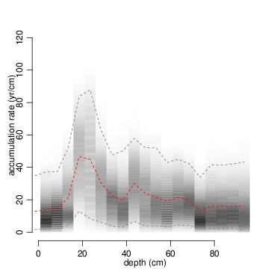
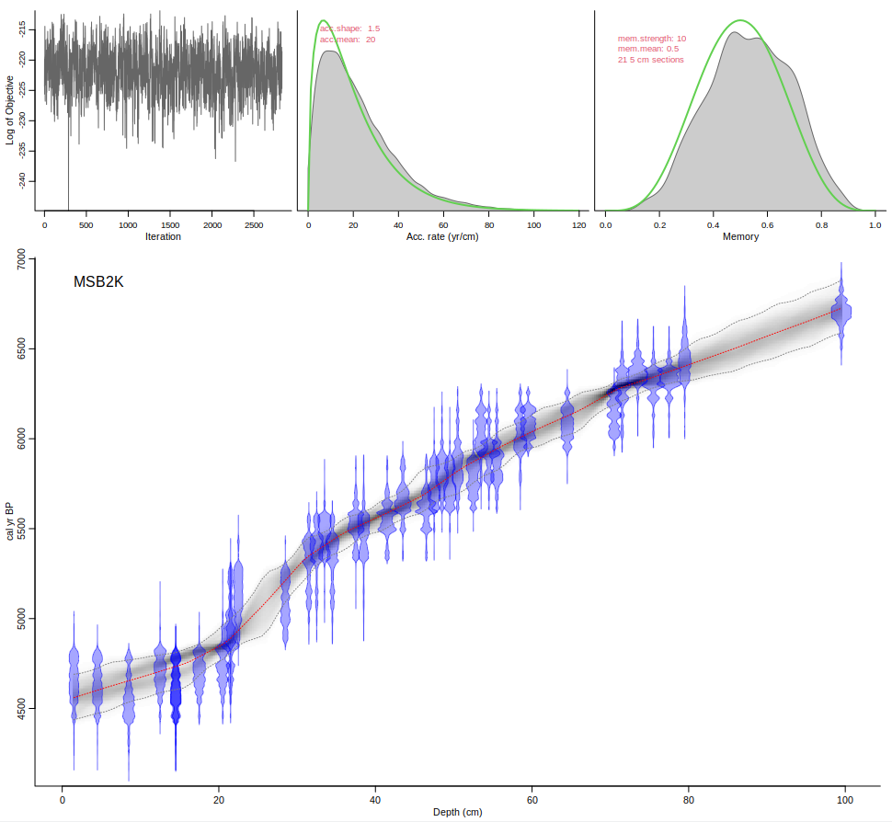
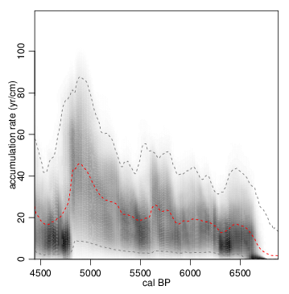
20 5-cm sections

Slide 22
Bacon - options
A model with fewer, thicker sections:
Bacon(, 30)
(here do NOT accept the suggested alternative section thickness)
Or, impose a hiatus at 23 cm depth:
Bacon( hiatus.depth=23)
Or, there was a thick tephra at 23-20 cm depth:
Bacon( slump=c(23,20))
To see all Bacon’s options, type:
?Bacon

Slide 23
Bacon - options
A model with an adapted mean for the prior of the accumulation rate:
Bacon(, acc.mean=30)

Slide 24
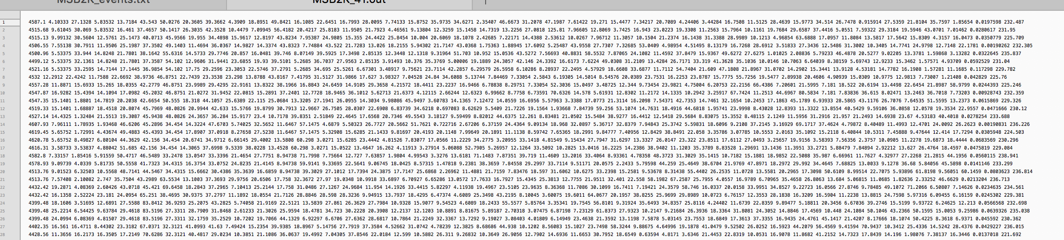
Bacon – output file

Slide 25
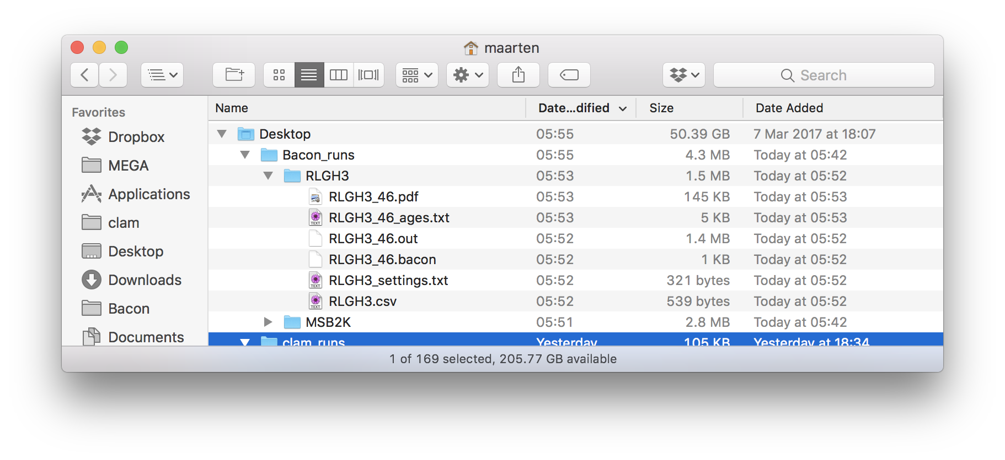
Bacon - options
A different core:
Bacon(“RLGH3”)

Slide 26
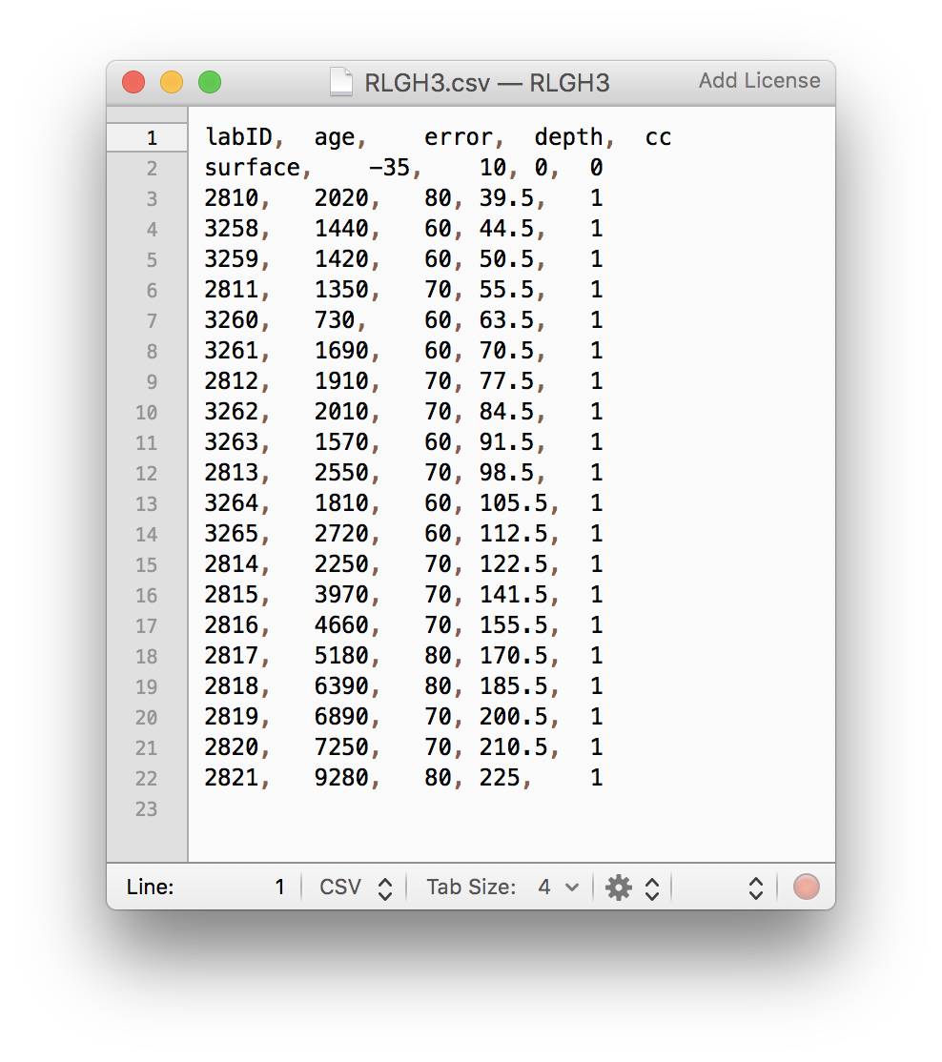
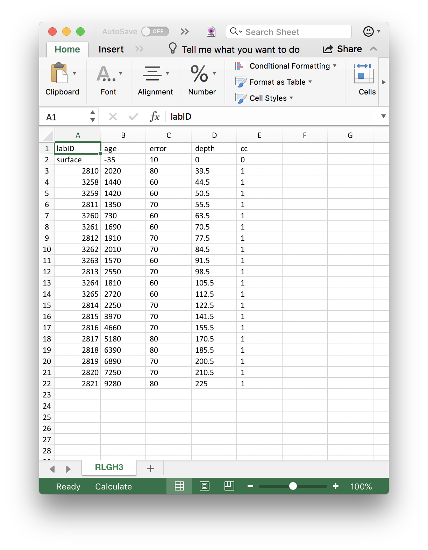
Notes:
<number>

Slide 27
Bacon – depths
Default every cm from top to bottom depth
d.by=1, can be set to other depths
Or make a variable depths and provide it:
    my.depths <- seq(0, 100, by=3)
    Bacon(depths=my.depths)
Or place depths as 1 column in a plain.text file
    File should end in _depths.txt
    Bacon(depths.file=TRUE)

Slide 28
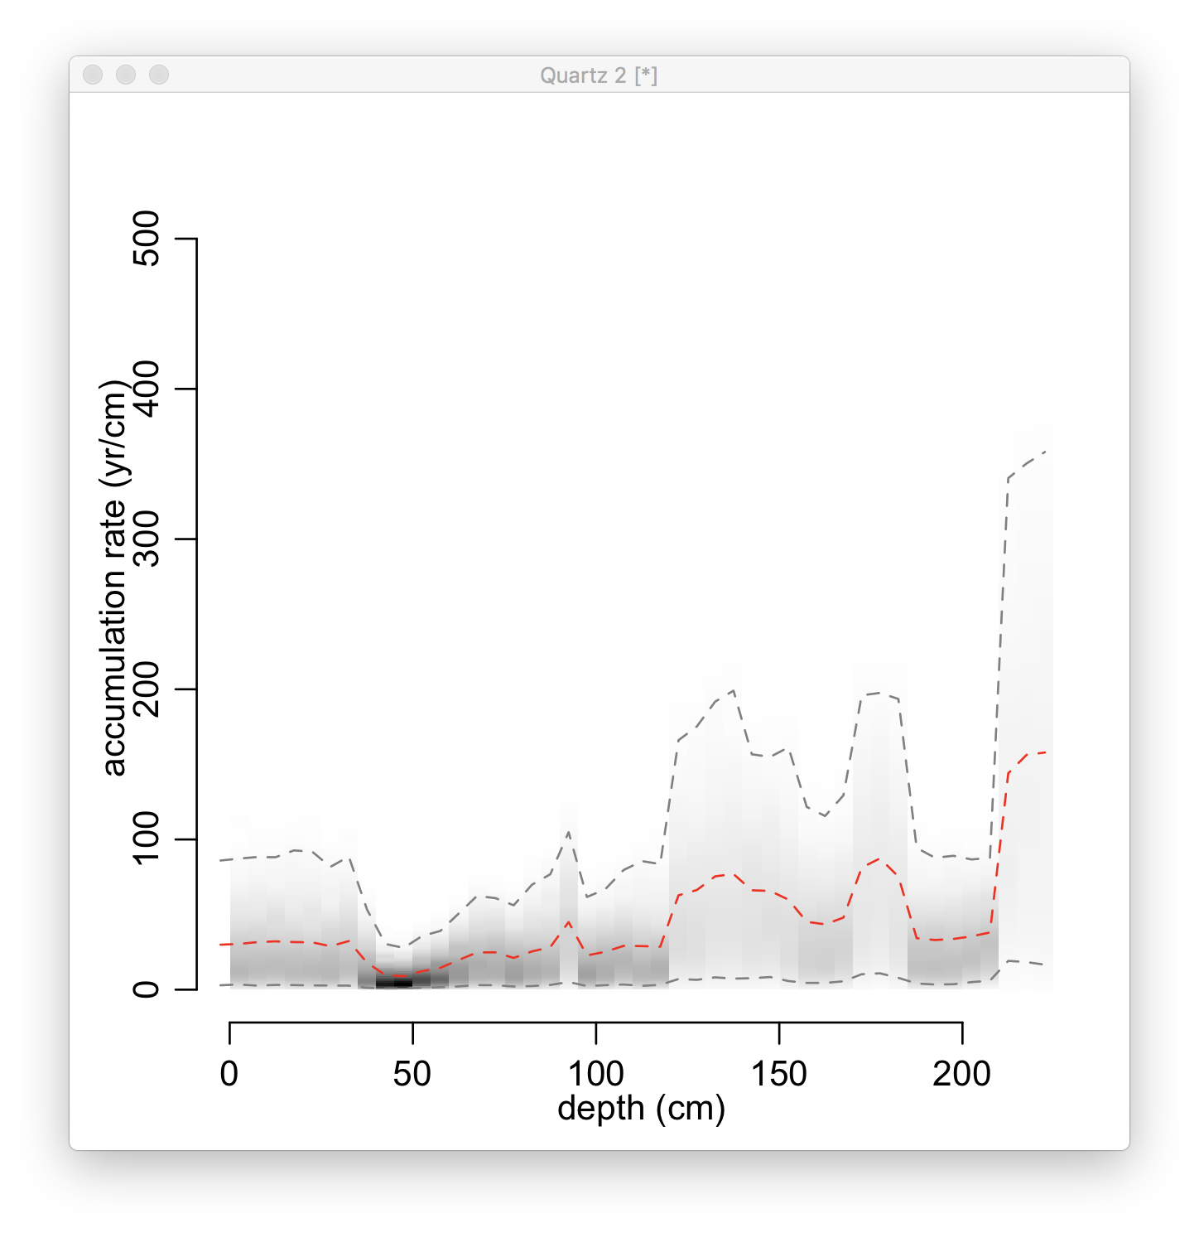
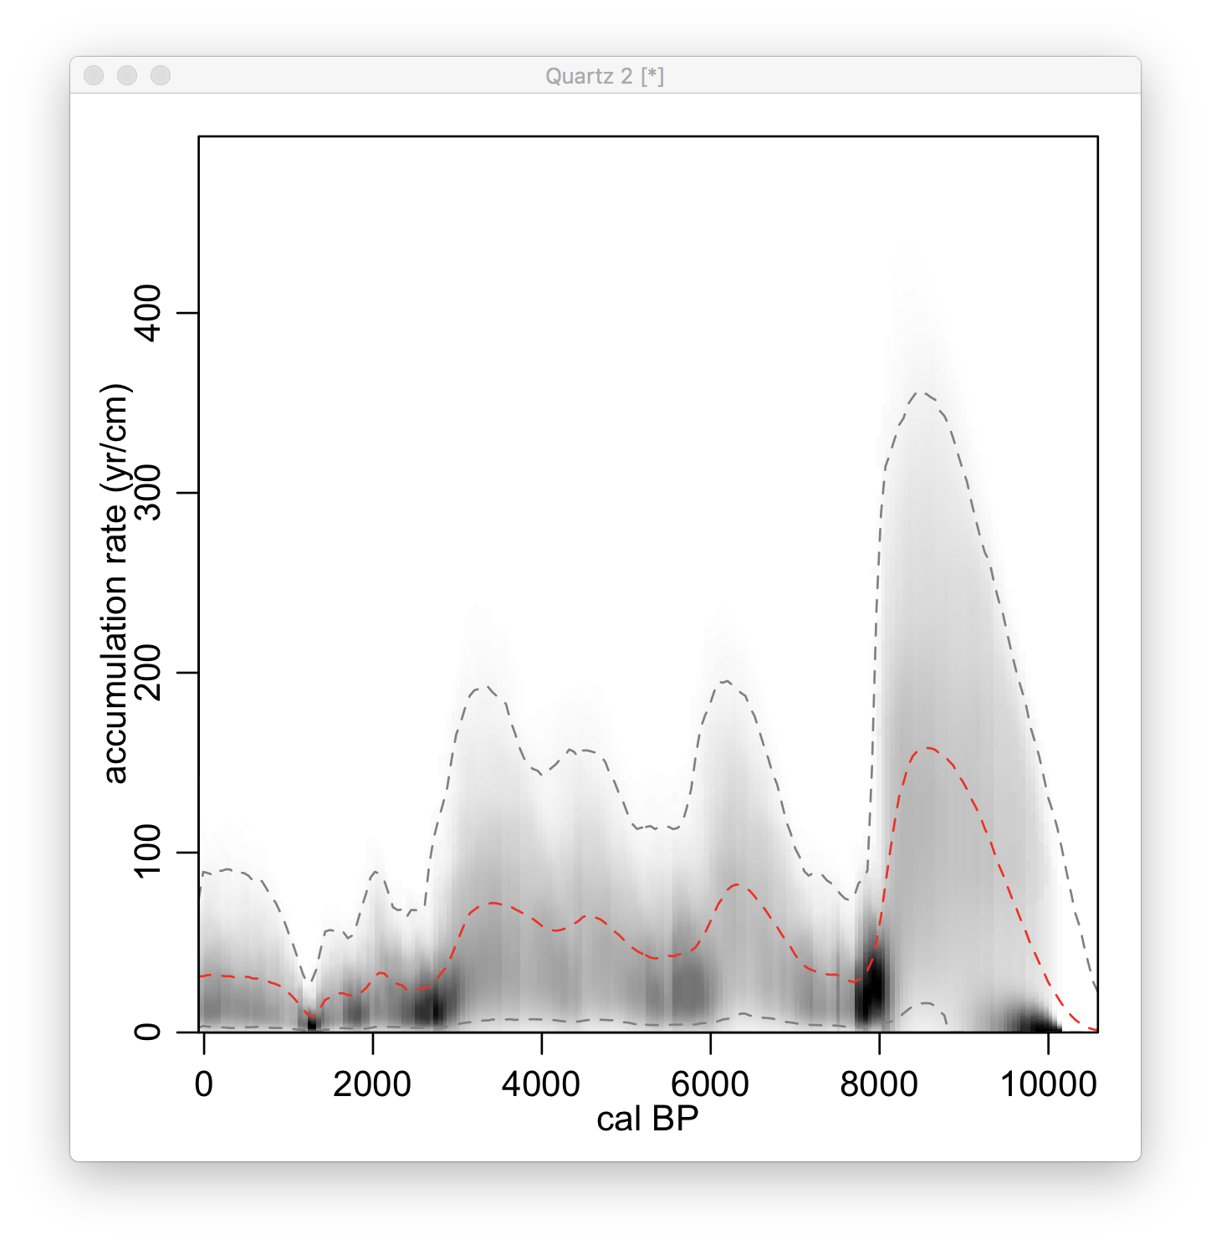
Bacon – post-run analysis
Reload an existing run:
Bacon(“RLGH3”, run=FALSE)
agedepth()
Plot accumulation rate vs depth:
accrate.depth.ghost()
Or against age:
accrate.age.ghost()

Slide 29
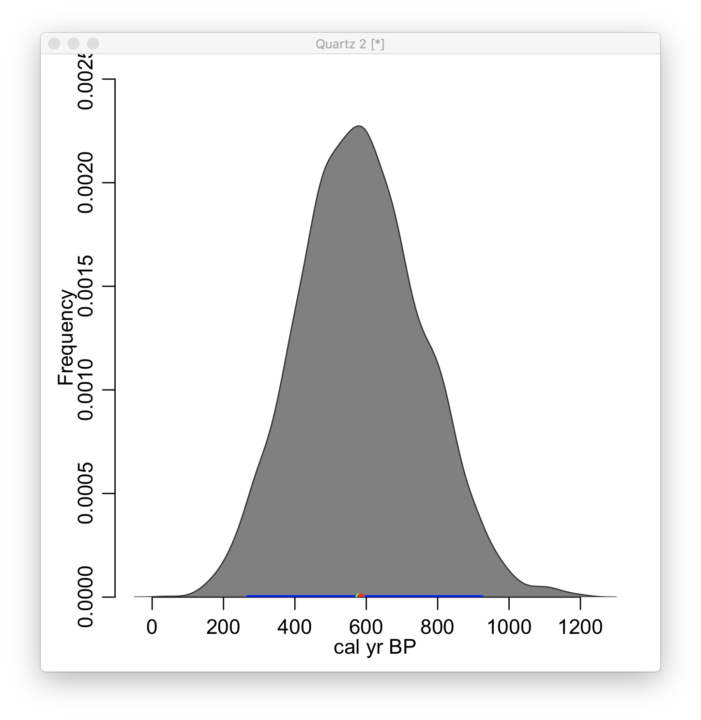
Bacon – post-run analysis
Plot the age estimate of a single depth:
Bacon.hist(20)
Or calculate time between depths:
d100 <- Bacon.Age.d(100)
d100
d50 <- Bacon.Age.d(50)
d100-d50
plot(d100-d50)
hist(d100-d50)

Slide 30
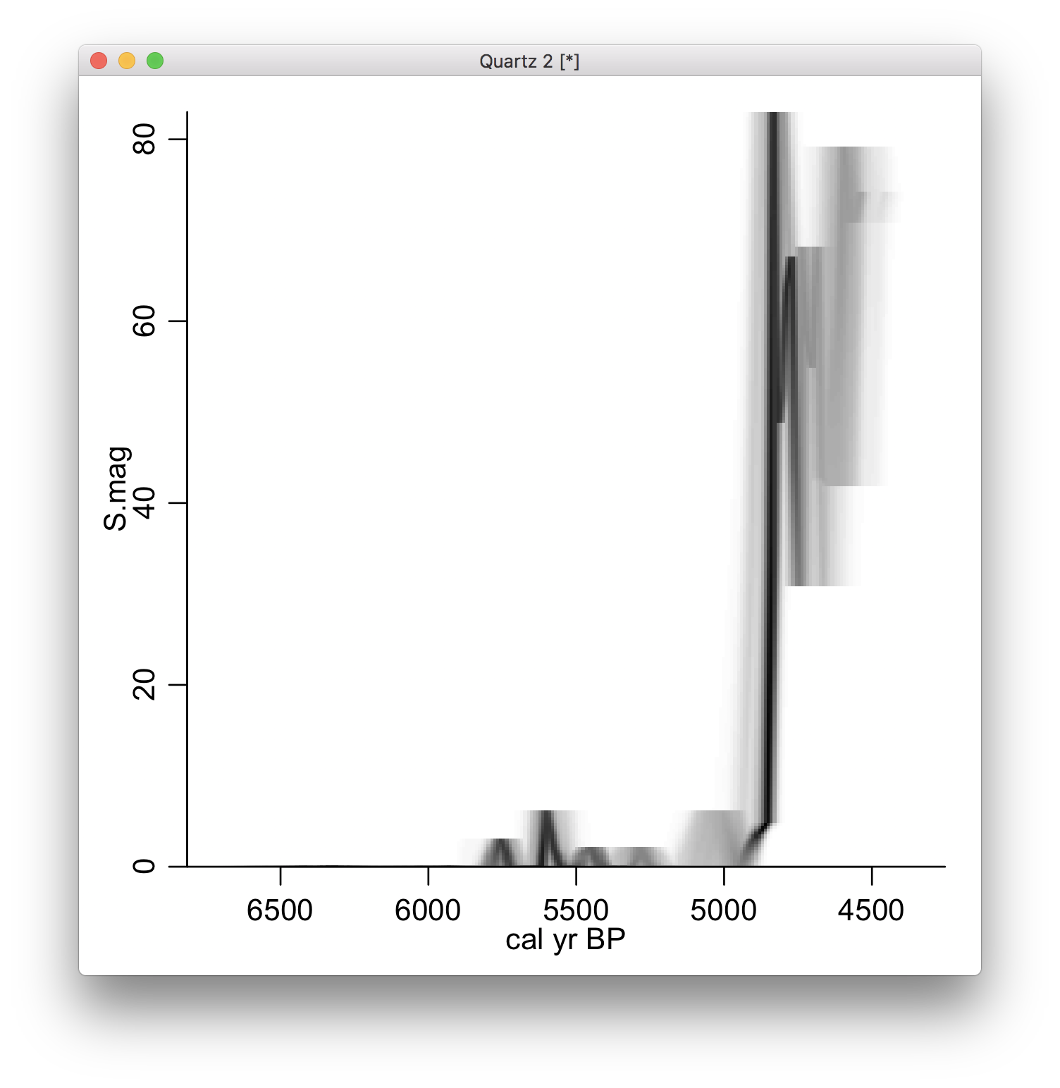
Bacon – post-run analysis
Plot a proxy against age (fourth proxy in MSB2K_proxies.csv:
Bacon(run=F)
layout(1)
proxy.ghost(4)

Slide 31
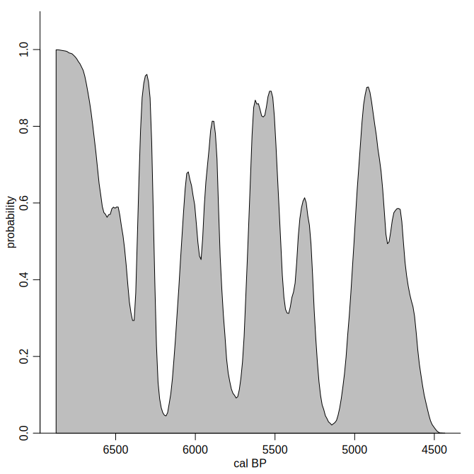

AgesOfEvents
To find probabilities of events (expressed against depth) against time, using windows
AgesOfEvents(100,1)

